Slide 1
Cornerstone City Church Peninsula Plus Community Hoo Are Ya
8th September 2024

Slide 2


Slide 3


Slide 4
God Is For Us
CCLI Song # 7121853
James Ferguson | James Tealy | Jesse Reeves | Jonny Robinson | Michael Farren | Rich Thompson | Tiarne Tranter
© 2018 BEC Worship; WriterWrong Music; CityAlight Music; Farren Love And War Publishing; Integrity's Alleluia! Music; My Eleiht Songs
For use solely with the SongSelect® Terms of Use. All rights reserved. www.ccli.com
CCLI Licence No. 33265

Slide 5
1/6
We won't fear the battle
We won't fear the night
We will walk the Valley with You by our side
You will go before us
You will lead the way
We have found a refuge only You can save

Slide 6
2/6
Chorus
Sing with joy now our God is for us
The Father's love is a strong and mighty fortress
Raise your voice now no love is greater
Who can stand against us if our God is for us

Slide 7
3/6
Even when I stumble
Even when I fall
Even when I turn back still Your love is sure
You will not abandon
You will not forsake
You will cheer me onward with never ending grace

Slide 8
4/6
Chorus
Sing with joy now our God is for us
The Father's love is a strong and mighty fortress
Raise your voice now no love is greater
Who can stand against us if our God is for us

Slide 9
5/6
Neither height nor depth can separate us
Hell and death will not defeat us
He who gave His Son to free us
Holds me in His love (REPEAT)

Slide 10
6/6
Chorus
Sing with joy now our God is for us
The Father's love is a strong and mighty fortress
Raise your voice now no love is greater
Who can stand against us if our God is for us

Slide 11
House Of The Lord
CCLI Song # 7168995
© 2020 Phil Wickham MusicSimply Global SongsBe Essential SongsCashagamble Jet Music
For use solely with the SongSelect® Terms of Use. All rights reserved. www.ccli.com
Note: Reproduction of this sheet music requires a CCLI Music Reproduction Licence. Please report all copies.
CCLI Licence No. 33265

Slide 12
1/9
We worship the God who was
We worship the God who is
We worship the God who evermore will be
He opened the prison doors
He parted the raging sea
My God He holds the victory yeah

Slide 13
2/9
There’s joy in the house of the Lord
There’s joy in the house of the Lord today
And we won’t be quiet
We shout out Your praise

Slide 14
3/9
There’s joy in the house of the Lord
Our God is surely in this place
And we won’t be quiet
We shout out Your praise

Slide 15
4/9
We sing to the God who heals
We sing to the God who saves
We sing to the God who always makes a way
'Cause He hung up on that cross
Then He rose up from that grave
My God’s still rolling stones away

Slide 16
5/9
There’s joy in the house of the Lord
There’s joy in the house of the Lord today
And we won’t be quiet
We shout out Your praise

Slide 17
6/9
There’s joy in the house of the Lord
Our God is surely in this place
And we won’t be quiet
We shout out Your praise

Slide 18
7/9
We were the beggars
Now we’re royalty
We were the prisoners
Now we’re running free
We are forgiven accepted
Redeemed by His grace
Let the house of the Lord sing praise
(REPEAT)

Slide 19
8/9
There’s joy in the house of the Lord
There’s joy in the house of the Lord today
And we won’t be quiet
We shout out Your praise

Slide 20
9/9
There’s joy in the house of the Lord
Our God is surely in this place
And we won’t be quiet
We shout out Your praise

Slide 22
This is Our God
CCLI Song # 7211413
Brandon Lake | Pat Barrett | Phil Wickham | Steven Furtick
© Brandon Lake Music; Phil Wickham Music; Simply Global Songs; Capitol CMG Genesis; Housefires Sounds; Music by Elevation Worship Publishing
For use solely with the SongSelect® Terms of Use. All rights reserved. www.ccli.com
CCLI Licence No. 33265

Slide 23
1/9
Remember those walls that we called sin and shame
They were like prisons that we couldn’t escape
But He came and He died and He rose
Those walls are rubble now

Slide 24
2/9
Remember those giants we called death and grave
They were like mountains that stood in our way
But He came and He died and He rose
Those giants are dead now

Slide 25
3/9
This is our God this is who He is
He loves us
This is our God this is what He does
He saves us
He bore the cross beat the grave
Let heaven and earth proclaim
This is our God King Jesus

Slide 26
4/9
Remember that fear that took our breath away
Faith so weak that we could barely pray
But He heard every word every whisper
Now those altars in the wilderness
Tell the story of His faithfulness
Never once did He fail and He never will

Slide 27
5/9
This is our God this is who He is
He loves us
This is our God this is what He does
He saves us
He bore the cross beat the grave
Let heaven and earth proclaim
This is our God King Jesus

Slide 28
6/9
Who pulled me out of that pit
He did He did
Who paid for all of our sin
Nobody but Jesus

Slide 29
7/9
Who rescued me from that grave
Yahweh Yahweh
Who gets the glory and praise
Nobody but Jesus (Him)

Slide 30
8/9
This is our God this is who He is
He loves us
This is our God this is what He does
He saves us
He bore the cross beat the grave
Let heaven and earth proclaim
This is our God King Jesus

Slide 31
9/9
He bore the cross beat the grave
Let heaven and earth proclaim
This is our God King Jesus

Slide 33
Evidence
CCLI Song # 7147432
Ed Cash | Ethan Hulse | Josh Baldwin
© 2020 Capitol CMG Paragon; We The Kingdom Music; Be Essential Songs; EGH Music Publishing; Bethel Music Publishing
For use solely with the SongSelect® Terms of Use. All rights reserved. www.ccli.com
CCLI Licence No. 33265

Slide 34
1/7
All throughout my history
Your faithfulness has walked beside me
The winter storms made way for spring
In every season from where I'm standing

Slide 35
2/7
I see the evidence of Your goodness
All over my life
All over my life
I see Your promises in fulfillment
All over my life
All over my life

Slide 36
3/7
Help me remember when I'm weak
Fear may come but fear will leave
You lead my heart to victory
You are my strength and You always will be

Slide 37
4/7
I see the evidence of Your goodness
All over my life
All over my life
I see Your promises in fulfillment
All over my life
All over my life

Slide 38
5/7
See the cross the empty grave
The evidence is endless
All my sin rolled away
Because of You oh Jesus (oh)

Slide 39
6/7
I see the evidence of Your goodness
All over my life
All over my life
I see Your promises in fulfillment
All over my life
All over my life

Slide 40
7/7
Why should I fear
(Oh) The evidence is here

Slide 41
Worthy Of it All
CCLI Song # 6280644
David Brymer | Ryan Hall
© 2012 Common Hymnal Publishing (Admin. by Integrity Music Ltd)
Innerland (Admin. by Integrity Music Ltd)
Underground Treasure (Admin. by Integrity Music Ltd)
Wayfinder Music (Admin. by Integrity Music Ltd)
For use solely with the SongSelect® Terms of Use. All rights reserved. www.ccli.com
CCLI Licence No. 33265

Slide 42
1/3
All the saints and angels
Bow before Your throne
All the elders cast their crowns
Before the Lamb of God and sing

Slide 43
2/3
You are worthy of it all
You are worthy of it all
For from You are all things
And to You are all things
You deserve the glory

Slide 44
3/3
Day and night,
Night and day,
Let incense arise
(X4)
Day and night
Night and day

Slide 45
1/1
Then sings my soul, My Saviour God, to Thee,
How great Thou art, How great Thou art.
Then sings my soul, My Saviour God, to Thee,
How great Thou art, How great Thou art!

Slide 46


Slide 47
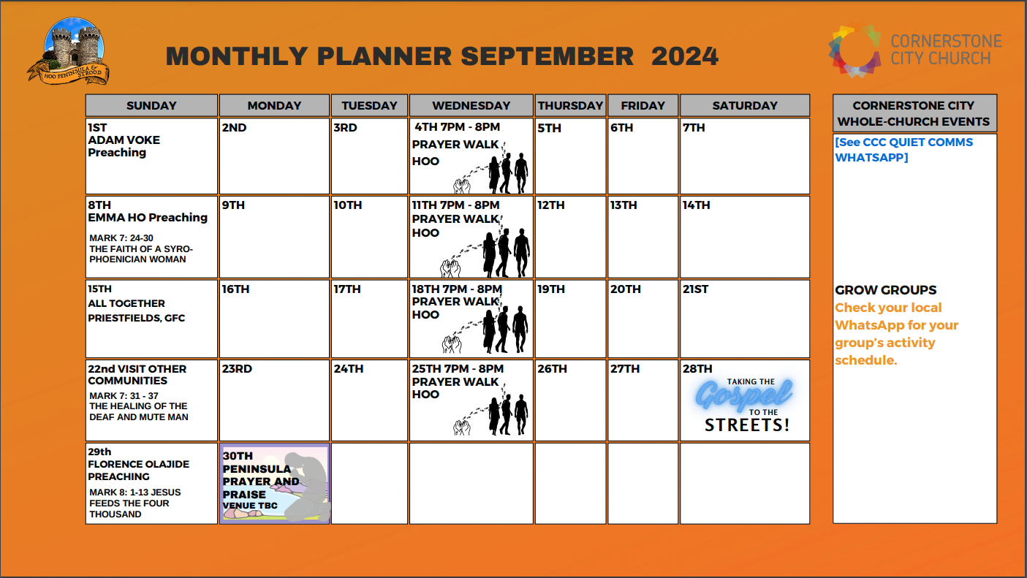

Slide 48


Slide 49


Slide 50
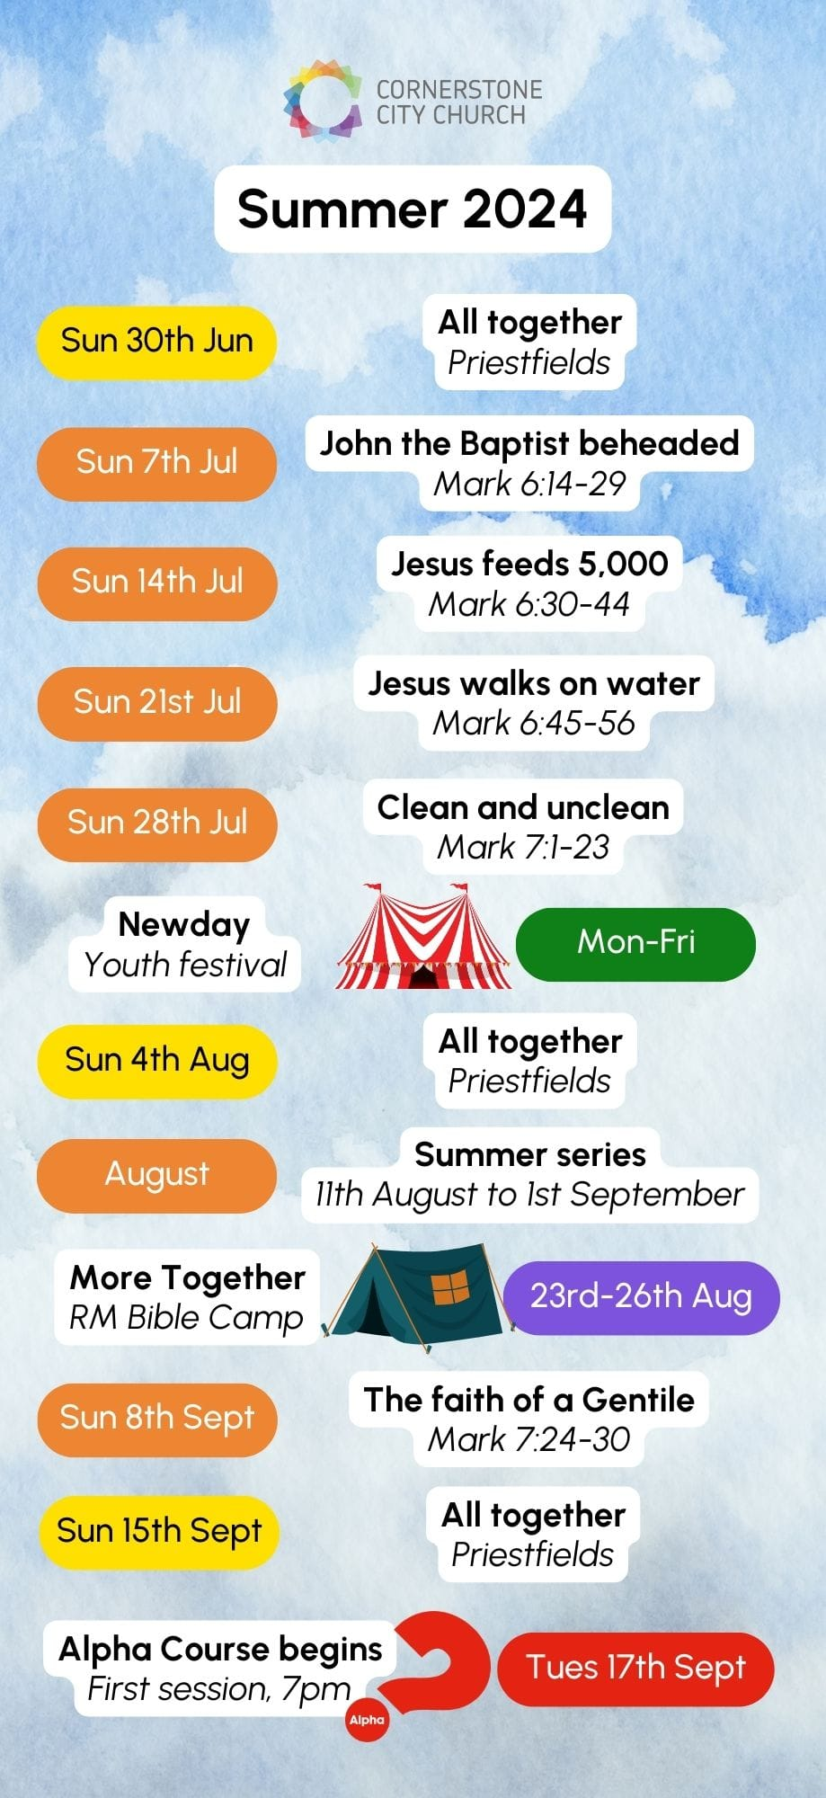

Slide 51


Slide 52
2 Corinthians 14 May the grace of the Lord Jesus Christ, and the love of God, and the fellowship of the Holy Spirit be with you all

